Slide 1
Barangay Human Development
OpenBangsamoro
George Bernardo
Alejandro Ibanez
Karissa O'Harra

Slide 2
Human Development
Human development – or the human development approach - is about expanding the richness of human life, rather than simply the richness of the economy in which human beings live. It is an approach that is focused on people and their opportunities and choices.
Source: http://hdr.undp.org/en/humandev

Slide 3
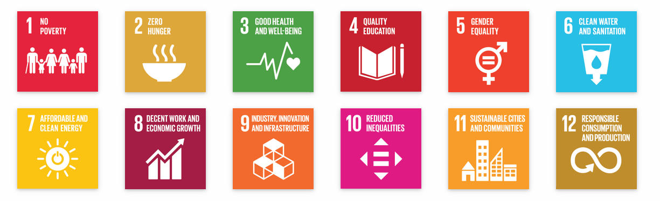
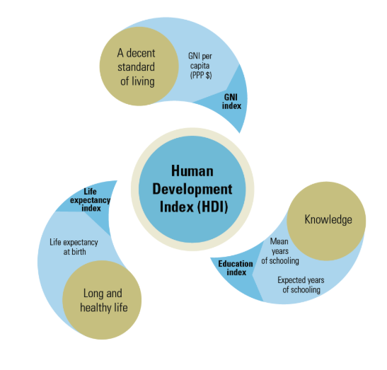

Human Development Index and SGD

Slide 4
Human Development Index
The Human Development Index (HDI) is a tool to measure the overall achievements in three basic dimensions of human development, namely, longevity, knowledge, and a decent standard of living.
It is premised on the principle that human development cannot be measured by the yardstick of income alone since income is a means, not an end, and there is no automatic link between income growth and human progress.
Source: http://www.hdn.org.ph/human-development-index-hdi/

Slide 5
The value of HDI ranges from 0 to 1.
An HDI very close to 1 means that the barangay had very high values of each of three components above.
Since these components are attempts to measure the development of the human being, a high HDI means that a high level of human development has been achieved.
Internationally, a country with an HDI of.80 or higher is said to have a high level of human development. On the other end of the pole are countries with an HDI lower than .50.

Slide 6
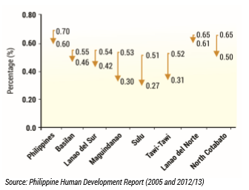
Human Development Index, Bangsamoro 2000-2009
Notes:
add barangay Info

Slide 7
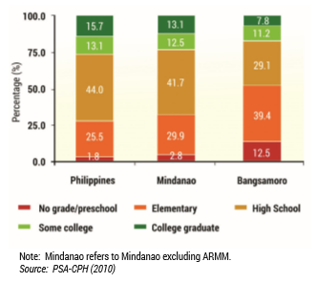
Educational Attainment, All Ages (2010)
Notes:
add Barangay Info

Slide 8
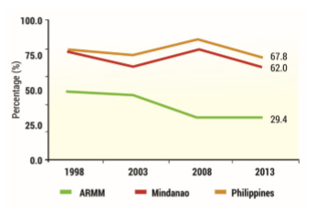
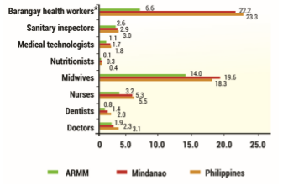


Percent of Children (12-23 months Old) who received basic vaccination (1998 - 2013)
Government Health Workers per 100k Population 2011
Notes:
add barangay info

Slide 9
Benefits
Much of the responsibility to help improve Filipinos’ quality of life has to be monitored and implemented at the local unit, relevant information, particularly on issues affecting human development, will greatly help local leaders in planning and implementing effective programs or projects that will improve the lives of their constituencies.

Slide 10
Recommendation
Capacity building at the barangay level in data gathering, data cleansing, storage, and transmission to contribute accurate data at the national level.

Slide 11
THANK YOU!

